Slide 1

A7045- Major Project
Domain: SIP Domain
DEEP-LEARNING APPROACH FOR BRAIN TUMOR CLASSIFICATION
Team No. – 2021040319
Presented by
21881A0486 - G. NIKHITHA
21881A0499 - K. JAYADIR REDDY
21881A04C0 - S. AADARSH
Under the Supervision of
T. Rama Krishnaiah
Assistant Professor, Dept. of ECE

Slide 2
Contents
Introduction
Motivation
Literature Survey
Problem Statement
Objective
Flow of Execution
References

Slide 3
Introduction
Brain tumor is a very common and it leads to a shorter life if it is not diagnosed early enough.
Magnetic Resonance Imaging (MRI) is a medical technique that uses magnetic fields and radio waves to create detailed images of the brain.
MRI is the best choice for brain tumor detection because it provides clear, detailed images of soft tissues without using harmful radiation. It helps doctors see tumor size, shape, and type more accurately than CT scans. MRI can also show if the tumor is aggressive and how it affects nearby brain areas. This makes it ideal for early detection, classification, and treatment planning.

Slide 4
This project focuses on building a deep learning system to classify brain MRI images into four categories: glioma, meningioma, pituitary tumor, and no tumor. It compares the performance of CNN, MobileNetV2, and DenseNet121 models using evaluation metrics like accuracy, precision, recall, and F1-score.
The best-performing model is then deployed through a web application. This helps users upload MRI images and receive instant classification results. The goal is to support faster and more accurate tumor diagnosis in medical settings.

Slide 5
Motivation
The motivation for our project comes from SDG 3: Good Health and Well-Being, With over 3 lakh cases reported globally each year and the incidence of brain tumors steadily rising, it has become a significant health concern. Early and accurate diagnosis is crucial for better patient prognosis.
Many regions lack skilled radiologists, but our AI-driven solution can bridge this gap, providing expert-level tumor detection in remote or underdeveloped areas, ensuring equal access to quality healthcare, in line with SDG 10: Reduced Inequalities.

Slide 6
Literature Survey
Title | Deep-learning-based computer-aided diagnosis tool for brain tumor classification
Journal Name and Year | 2021 11th International Conference on Cloud Computing, Data Science & Engineering (Confluence) IEEE
Authors | Sakshi ahuja,B.K Phanigrahi,Tapan Gandhi
Contribution | ResNet-v2
Parametric Analysis | Training Accuracy : 97%(2 classes , glioma, glioblastoma)

Slide 7
Title | Brain Tumor Classification Using Deep Learning
Journal Name and Year | 2020 International Conference on Assistive and Rehabilitation Technologies (iCareTech) IEEE
Authors | Ahmad Saleh ,Rozana Sukaik ,Samy S. Abu-Naser
Contribution | Inception-v3
Parametric Analysis | Training Accuracy : 92%(2 classes, Benign ,Malignant)

Slide 8
Title | Brain Tumour Detection Using Deep Learning
Journal Name and Year | 2021 Seventh International conference on Bio Signals, Images, and Instrumentation (ICBSII) IEEE
Authors | Avigyan Sinha , Aneesh R P , Malavika Suresh , Nitha Mohan , Abinaya D
Contribution | CNN
Parametric Analysis | Accuracy : 95%, predicted whether the tumor is present or not

Slide 9
Problem Statement
Manual diagnosis of brain tumors from MRI scans is time-consuming and can become challenging due to the visual similarity between different tumor types such as glioma, meningioma, and pituitary tumors.
These tumors may have overlapping features but vary in size, location, and shape, making accurate classification difficult. The lack of well-labeled medical data adds to the difficulty. Hospitals need fast and reliable methods to support accurate diagnosis in real-time situations.

Slide 10
Objective
Build a Deep Learning Classifier:
Create a deep learning system that can correctly identify and classify brain MRI images into four types: meningioma, pituitary tumor, glioma, and no tumor.
Evaluate and Compare Models:
Use different models like CNN, MobileNetV2, and DenseNet121 to train and test the system. Compare their performance using accuracy, precision, recall, F1-score, and confusion matrix.
Deploy Best Model Using Web Interface:
Choose the model with the best results and build a simple web application. The app should allow users to upload MRI images and view the classification results easily.

Slide 11
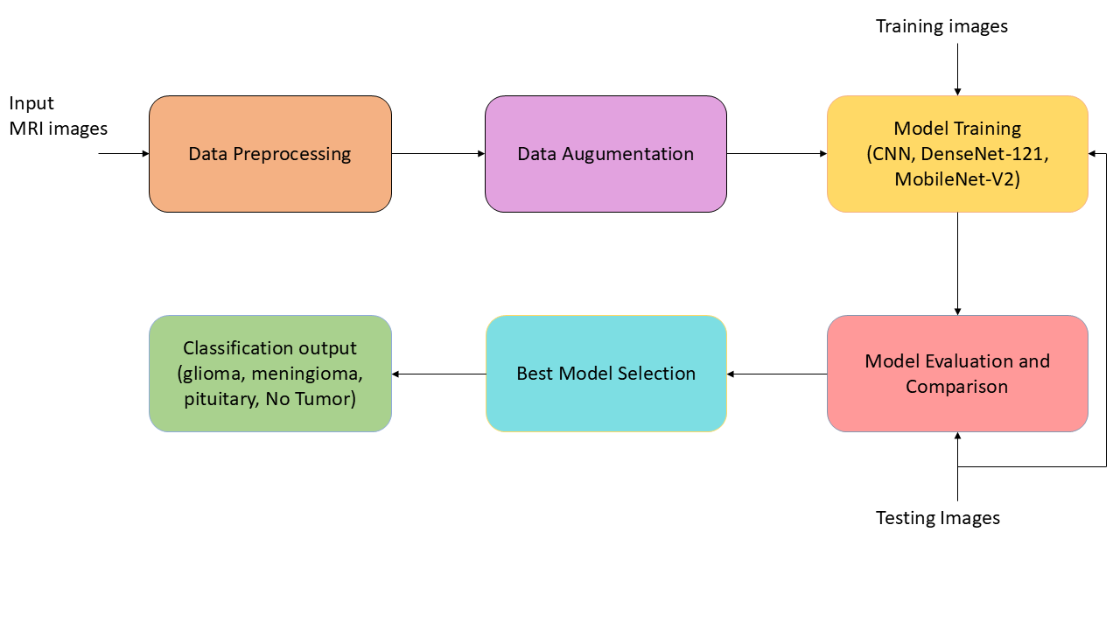
BLOCK DAIGRAM :
Fig :Block Diagram

Slide 12
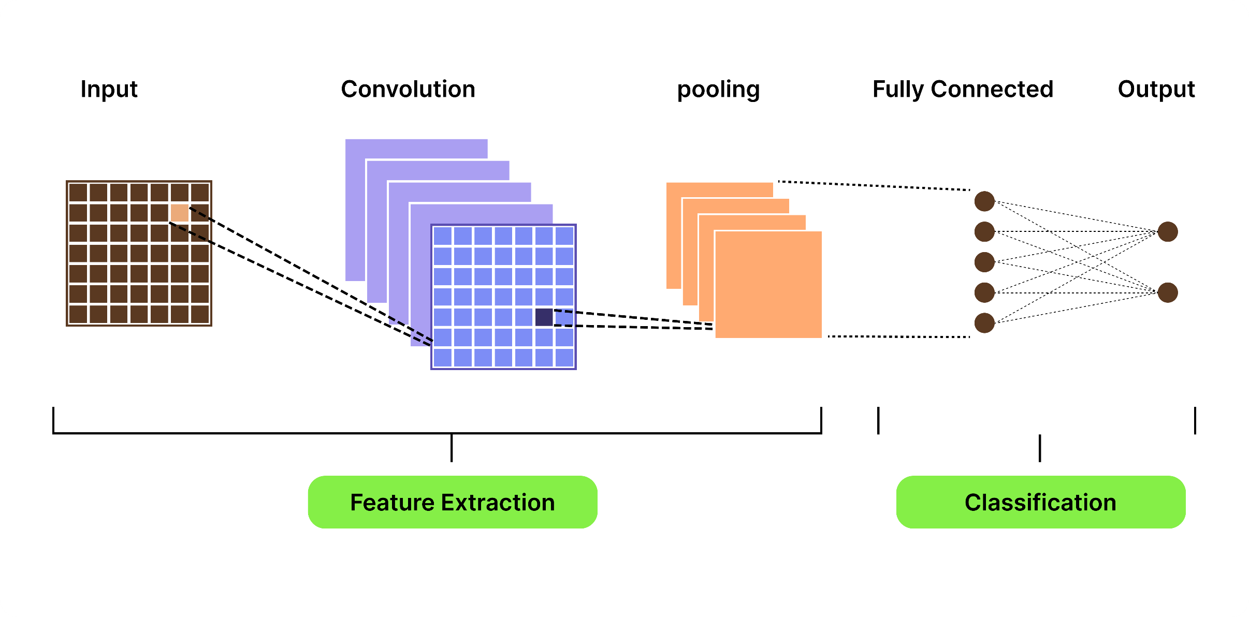
Fig : CNN Architecture

Slide 13
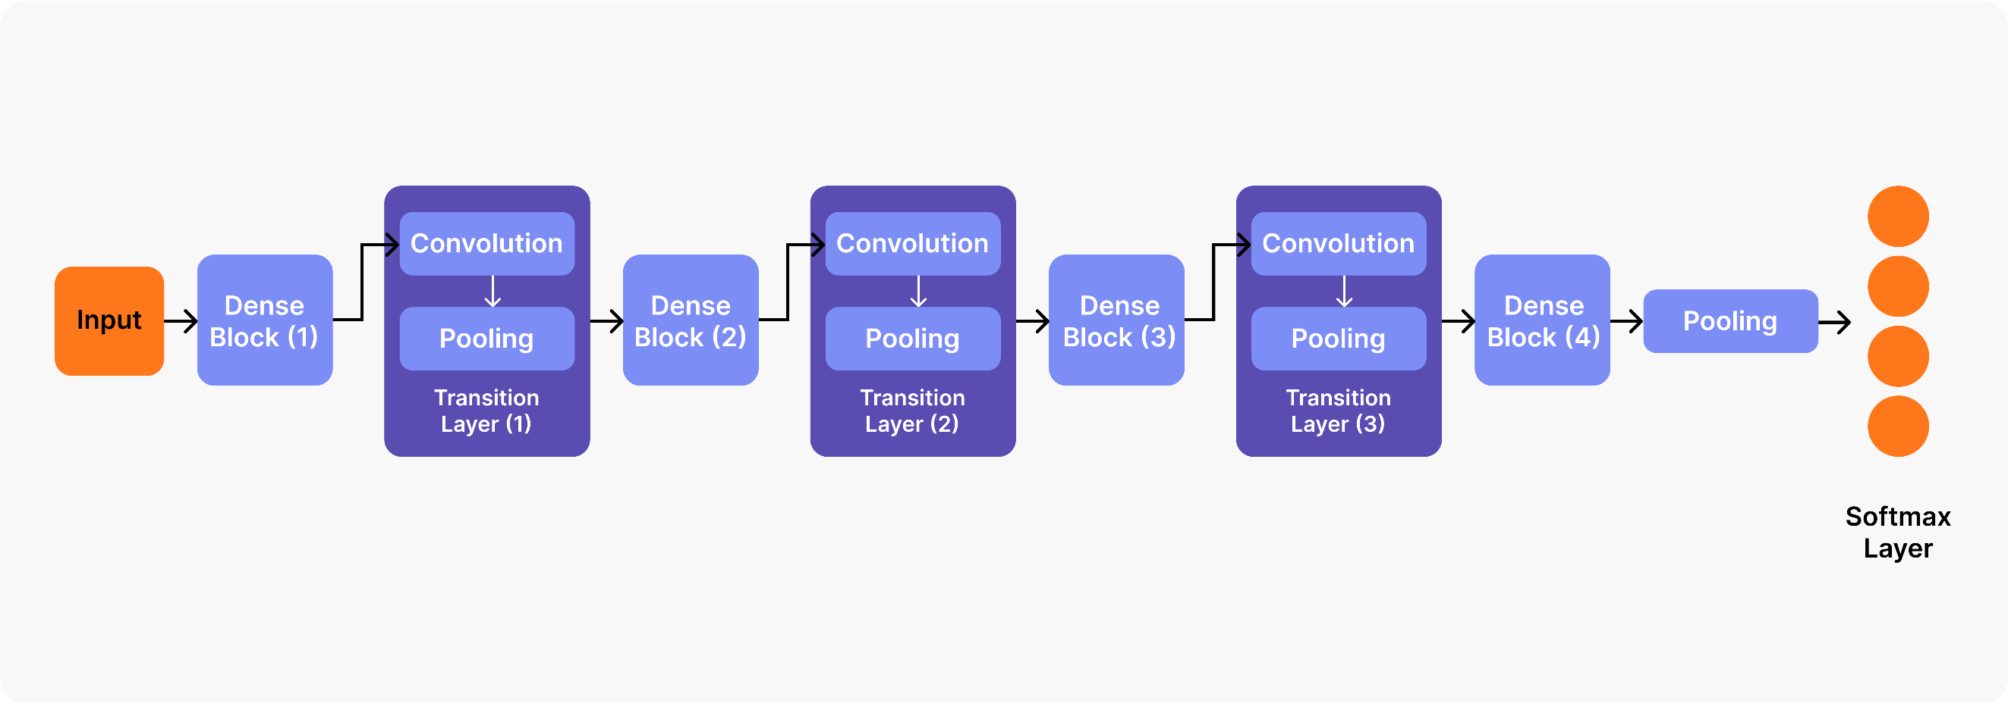
Fig : Dense Net Architecture

Slide 14
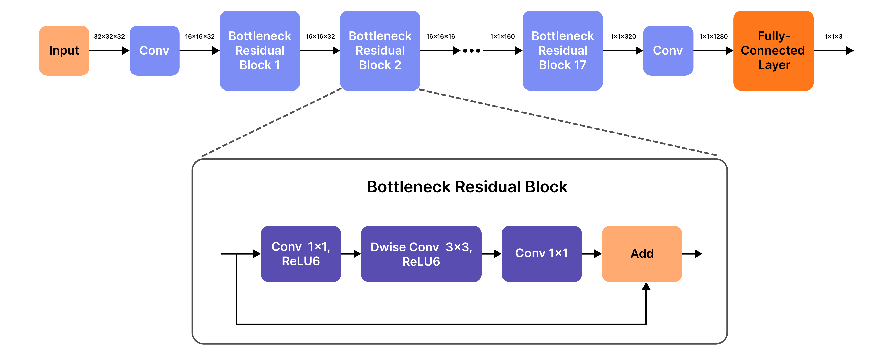
Fig : Mobile Net Architecture

Slide 15
  Convolutional Neural Network (CNN)
  CNNs automatically extract features from MRI images using a series of convolutional layers followed by max-pooling layers and ReLU activation functions. The convolutional layers focus on capturing low-level patterns like edges, textures, and shapes, while ReLU ensures non-linearity, helping the model learn more complex features. These features are automatically learned during training without any manual intervention.
  CNN acts as the starting point in the classification process, automatically extracting key features from MRI scans. While it is effective at detecting basic tumor patterns, it faces challenges when trying to generalize to new data, particularly in distinguishing between similar tumor types like glioma and meningioma. To overcome these limitations and improve performance, more advanced models like DenseNet121 and MobileNetV2 are used.

Slide 16
DenseNet-121
DenseNet121 uses dense connections between layers, where each layer receives input from all preceding layers. This helps in reusing features effectively and improving gradient flow. The model employs ReLU activation functions to capture non-linear relationships in the data, enabling the network to automatically learn complex tumor characteristics, including texture, shape, and location.
DenseNet121 improves feature extraction by capturing more detailed patterns, which helps in better for distinguishing between tumors like glioma and meningioma. However, its complex design requires a lot of computational power, making it slower and less suitable for real-time applications that need faster processing.
MobileNet-V2
MobileNetV2 automatically extracts features using depth wise separable convolutions and inverted residual blocks to efficiently capture essential tumor characteristics. The model uses ReLU6 activation functions, which are designed for better performance in mobile and web applications, ensuring quick and accurate classification even with limited computational resources.

Slide 17
MobileNetV2 offers the best performance for real-time, web-based deployment, as it provides a balance of accuracy, speed, and low resource consumption. The model’s efficient feature extraction and fast processing make it ideal for applications where quick tumor classification is needed, such as in medical facilities with limited computational power.
The final model, MobileNetV2, is deployed in a web application to provide real-time tumor classification. This web-based solution allows users to upload MRI images and receive instant predictions.
Web Interface: Users can interact with the system via a simple and intuitive Flask-based interface. Once users authenticate themselves, they can upload MRI images for classification.

Slide 18
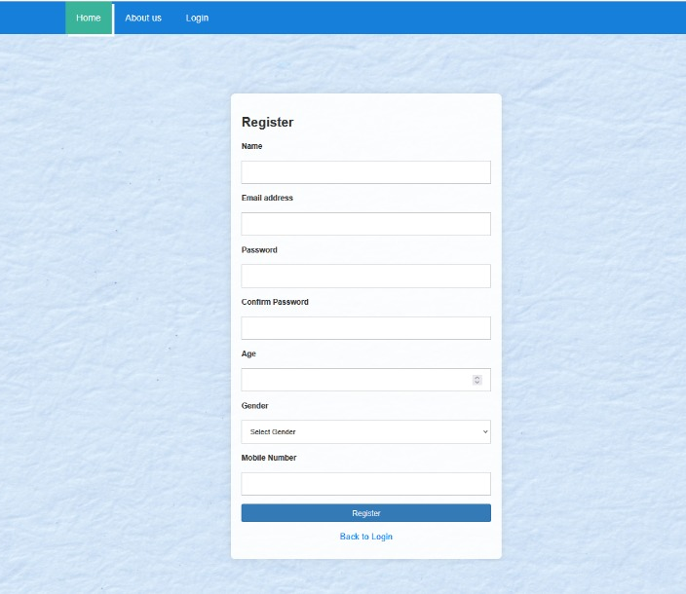
Results:
Fig : Login Page

Slide 19
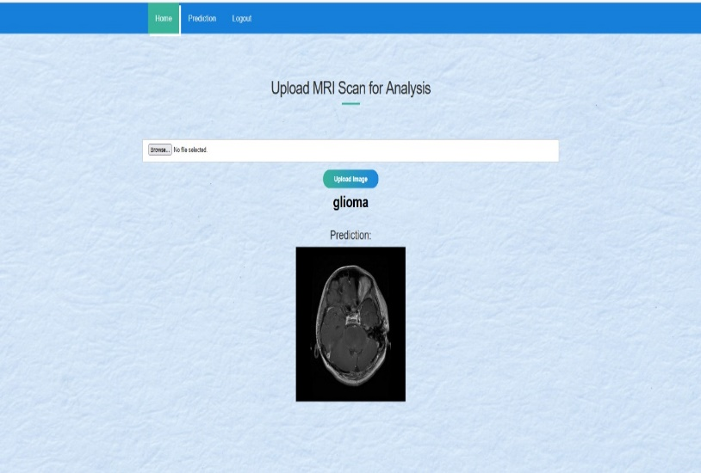
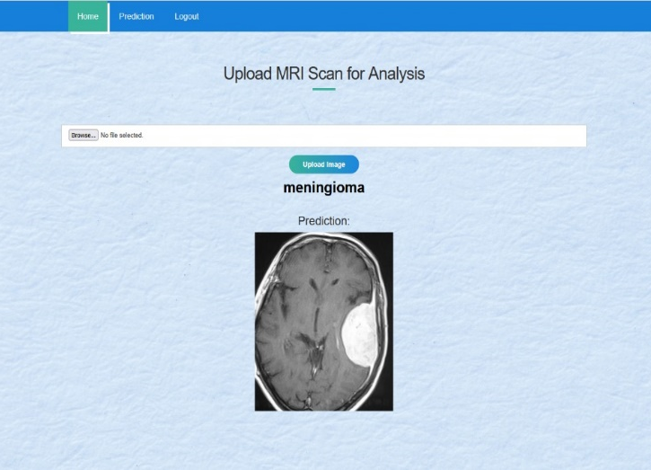
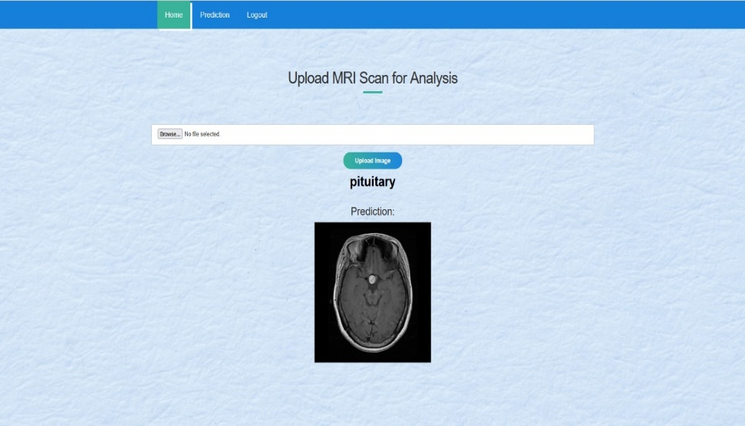
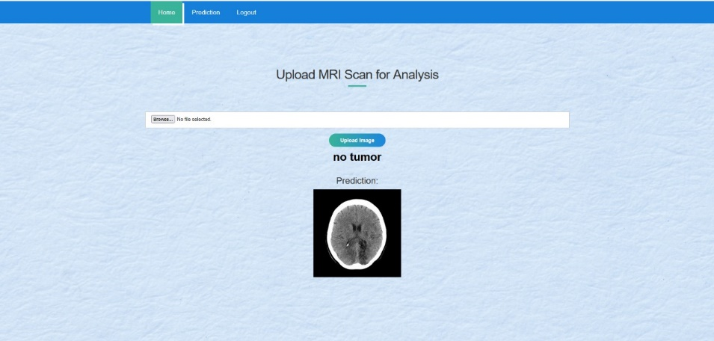
Fig : Predictions/outputs

Slide 20
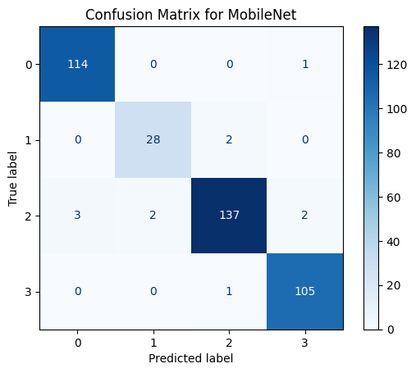
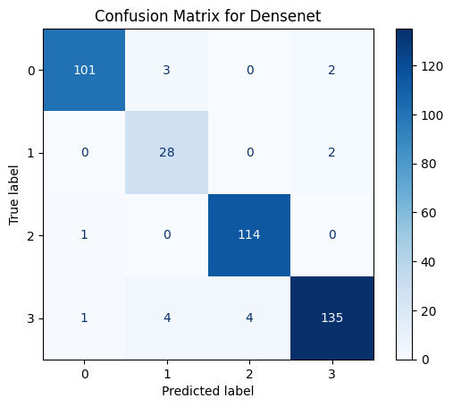
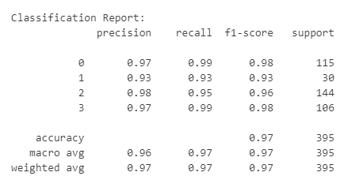
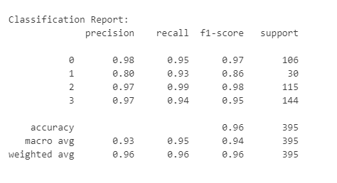
Fig : Confusion Matrices and Classification Reports

Slide 21
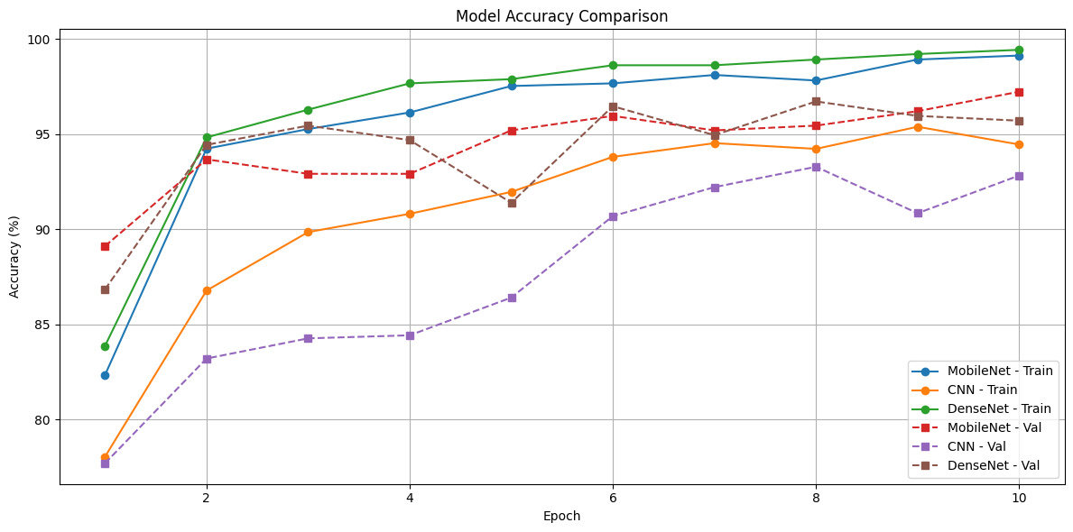
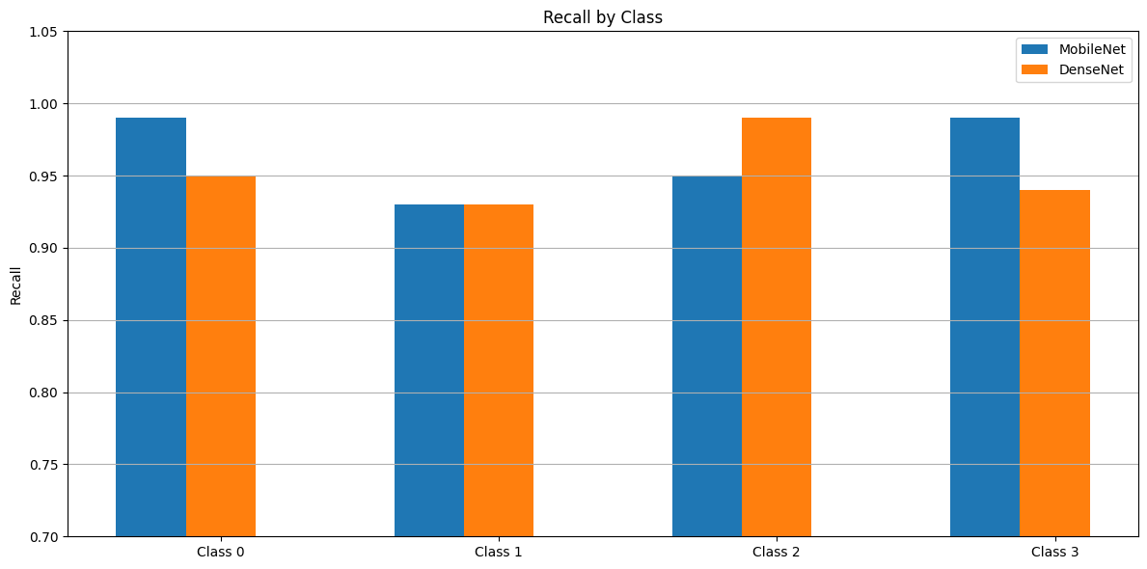
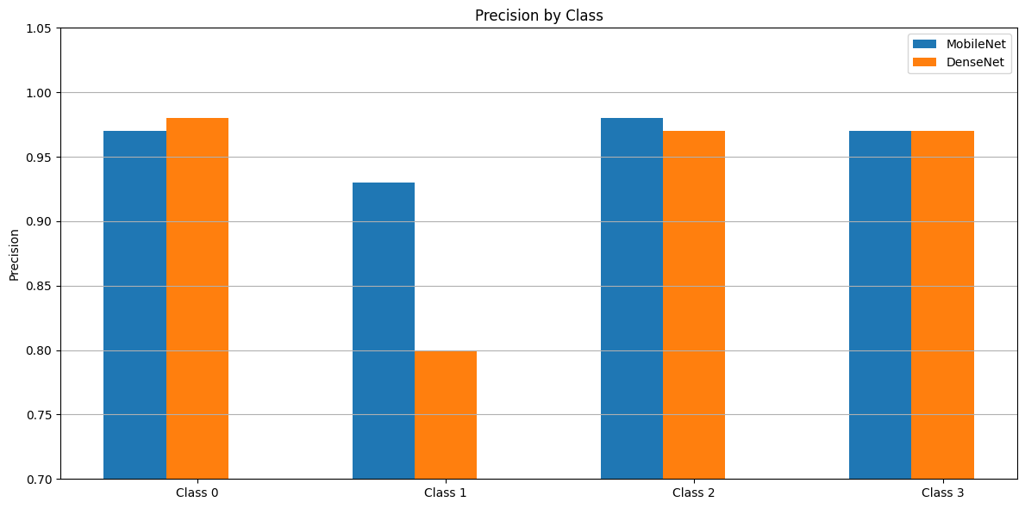
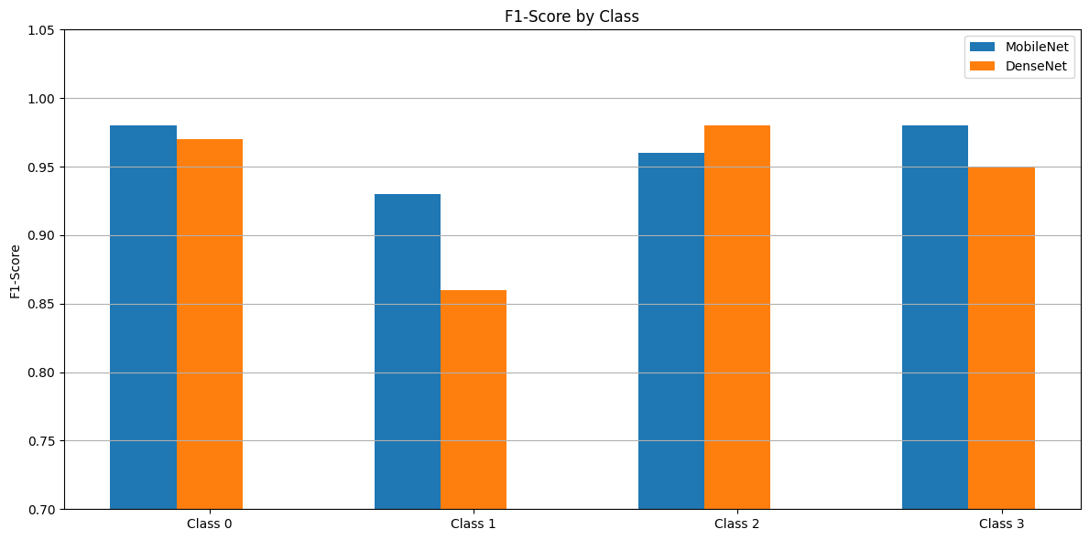
Fig : Model Accuracy and Validation Comparison Graphs

Slide 22
References
1. M. Gurbină, M. Lascu and D. Lascu, “Tumor Detection and Classification of MRI Brain Image using Different Wavelet Transforms and Support Vector Machines”, 42nd International Conference on Telecommunications and Signal Processing (TSP), Budapest, Hungary, 2019
2. Heisman, J., Taphoorn, M. Impact of brain tumour treatment on quality of life. J Neurol 249, 955–960 (2002)
3. Lavonne Chakrabarty, “Brain MRI Images for Brain Tumor Detection Dataset” , Kaggle , April 2019 .
4. Muhsen, Heba, et al. (2018). Classification using deep learningneural networks for brain tumors. Future Computing and Informatics Journal, 3(2), 68-71.

